Slide 1
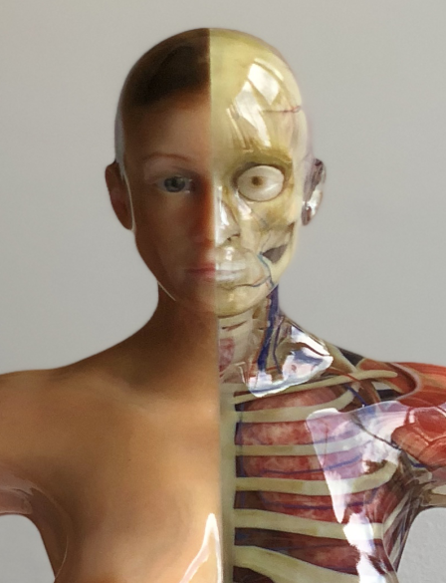
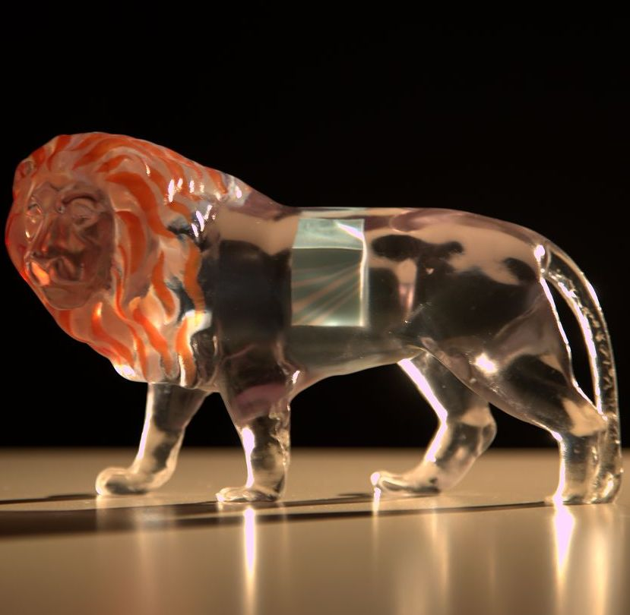
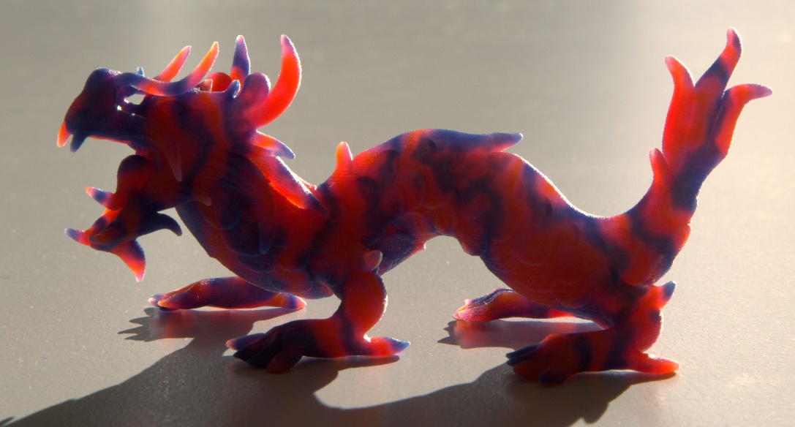
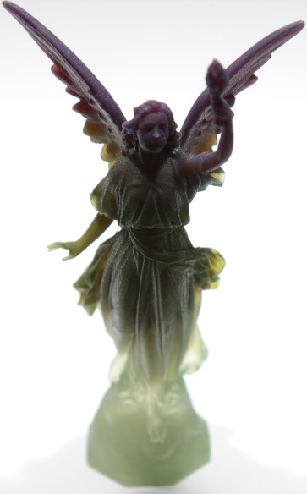
ReDefining A in RGBA: Towards a Standard for Graphical 3D Printing
Philipp Urban
Competence Center for 3D Printing Technology
Fraunhofer Institute for Computer Graphics Research (IGD)

Slide 2
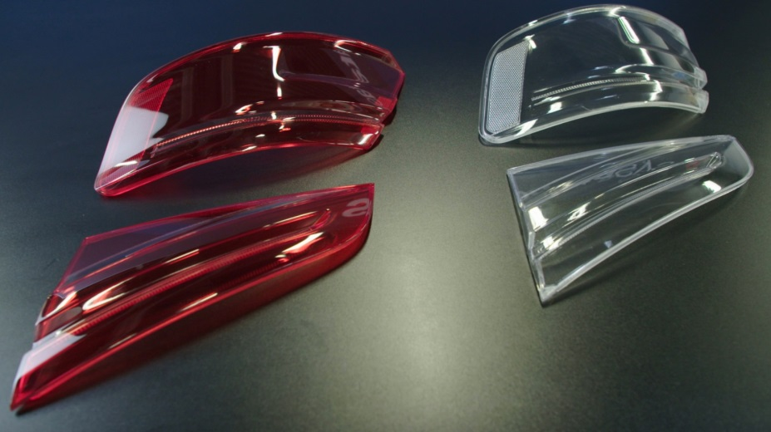
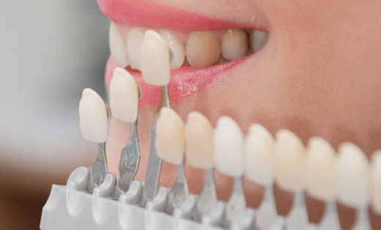
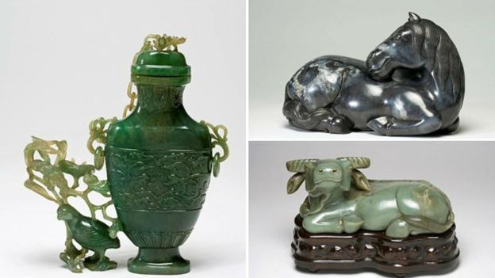
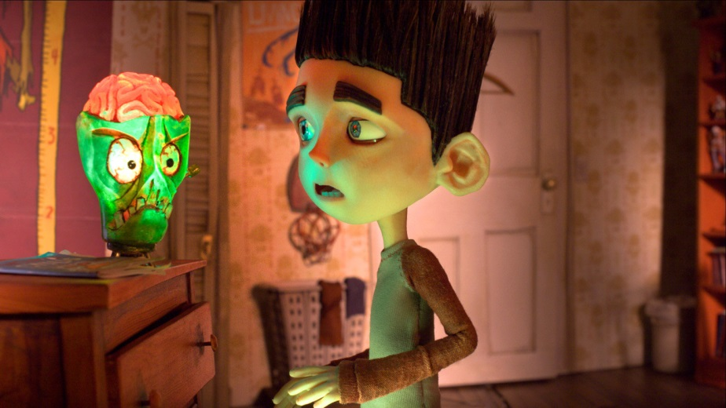

Application areas
Source: zahnaufhellung-friedrichshafen.de
Source: Audi
Design prototypes
Replacements parts fitting into existing visual environment
Source: bbc.com
Cultural heritage
Entertainment

Slide 3
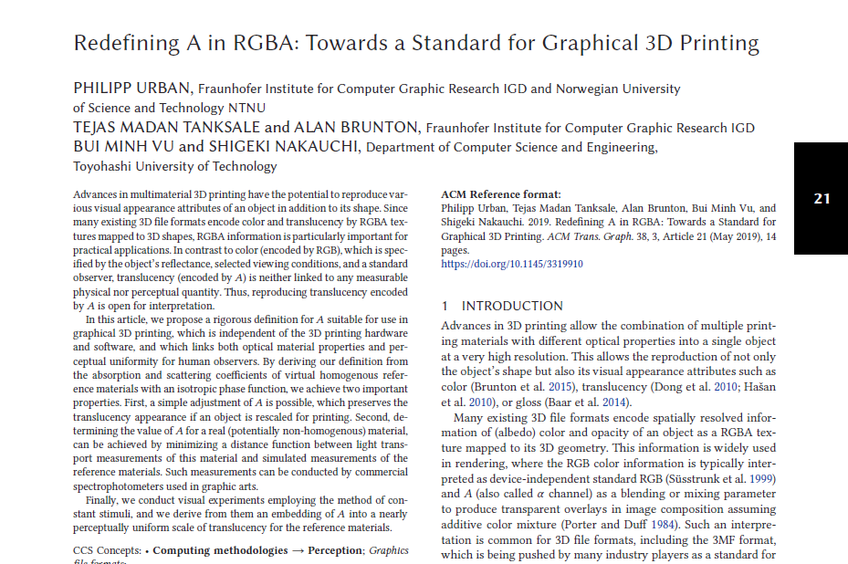
Redefining A in RGBA: Towards a Standard for Graphical 3D Printing
Philipp Urban, Tejas Madan Tanksale, Alan Brunton, Bui Minh Vu, Shigeki Nakauchi ACM Transactions on Graphics, Volume 38, Issue 3, Article 21, May 2019
Preprint on arXiv incl. Matlab scripts: https://arxiv.org/abs/1710.00546

Slide 4
International Color Consortium (ICC)

Slide 5

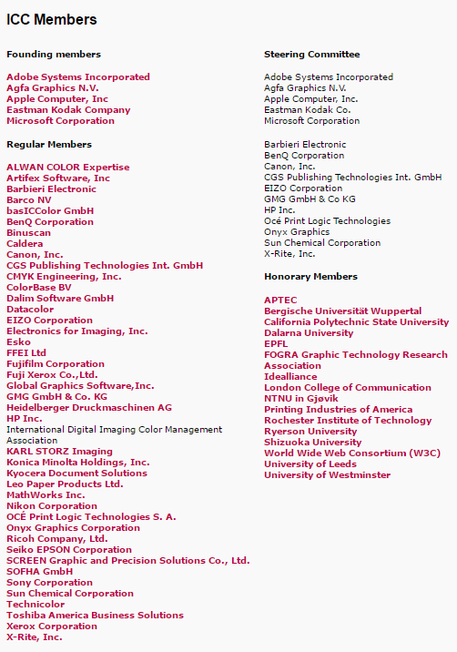
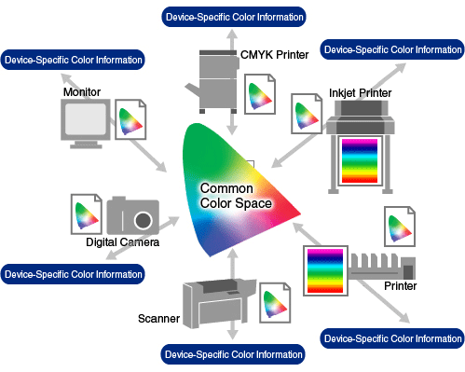
ICC established a standard for color management that is used worldwide by software and hardware companies
It is also an ISO standard: ISO 15076-1:2010
Open System Architeture

Slide 6
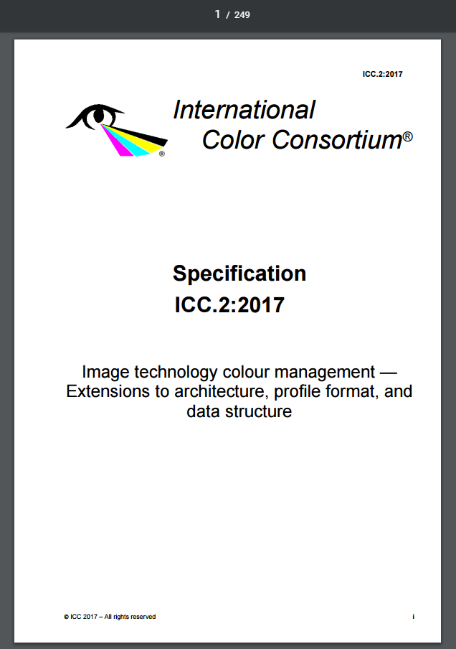
iccMAX
New standard called “iccMAX” introduced covering visual material properties beyond color, i.e. managing BRDFs, spectral, etc. information
ISO 20677
Open source reference implementation available
Is not linked to a specific file format, i.e. it can also be used together with OBJ, WRL and 3MF

Slide 7

iccMAX
Discussion with ICC’s Technical Secretary, Phil Green:
Define a specific iccMAX-“Interoperability Conformance Specification” (ICS) for RGBA (fill out the ICS form)
Register the ICS (it has to be approved by the ICC)
RGBA
(ICS)

Slide 8
File Format Requirements for Appearance 3D Printing

Slide 9
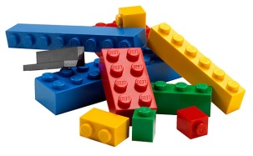
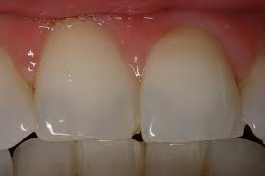
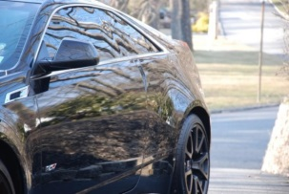
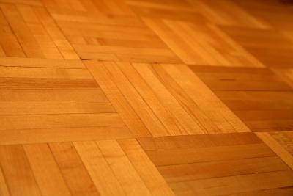
File Format Requirements for Appearance 3D Printing
General requirements:
File format has to store optical material properties / visual attributes (percepts for color, gloss, translucency, anisotropic color) in addition to 3D shape
Device independent
Optical material properties / visual attributes must be measureable
Low dimensional
A conversion into a perceptually-uniform space is desired (for process control, quality assurance, gamut mapping)
Practical/political constraints:
Defining an independent file format will not be accepted in industry → extension of an existing format
Small extensions → easier inclusion into format
Extensions in-line with other formats (e.g. measurement cond.) → easier inclusion into format
Data can already be encoded in existing file format (e.g. RGBA) → easier inclusion into format
color
Translucency
Gloss
anisotropic
color

Slide 10







Advantages to use RGBA for Color + Translucency Encoding
RGBA textured 3D models are
supported by various 3D file formats
can be created and modified by various 3D modeling tools
RGBA textures can be modified by image processing tools
RGBA is low dimensional

Slide 11
Open Questions in using RGBA for 3D printing
How to ensure device independence?
How to measure RGBA for real materials?
What about perceptual-uniformity? (for process control, quality assurance, gamut mapping)

Slide 12
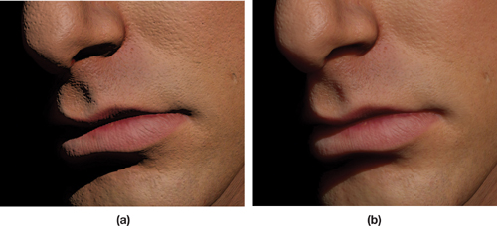
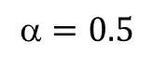
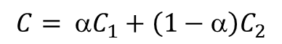
Problem with A in RGBA as a Blending Parameter
A is used as a blending parameter to produce transparent overlays in image composition assuming additive color mixture → physically wrong, just color
Does not describe lateral scattering (LS) → Texture or geometry blurring cannot be described
Is neither linked to any measurable physical nor perceptual quantity
(1,0,0)
(0.5,0,0.5)
Source :https://dqlin.xyz/tech/2016/12/02/03_sss/
(0,0,1)
$$=0.5$$
$$C= {αC}_{1}+\left(1−α\right)C_{2}$$
Not considering LS
considering LS

Slide 13
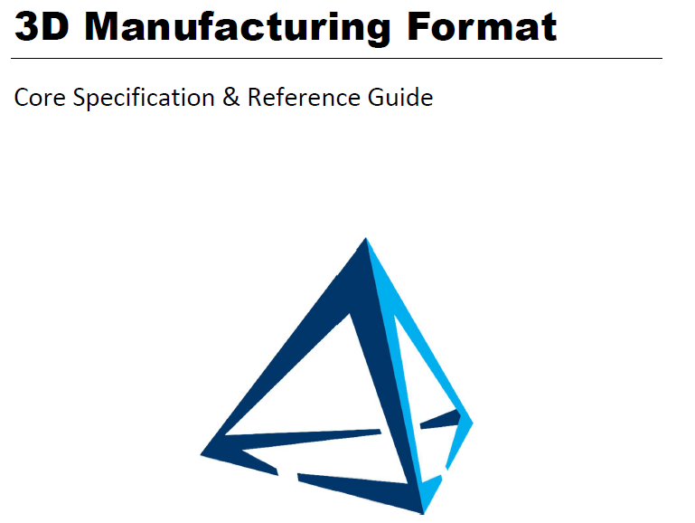
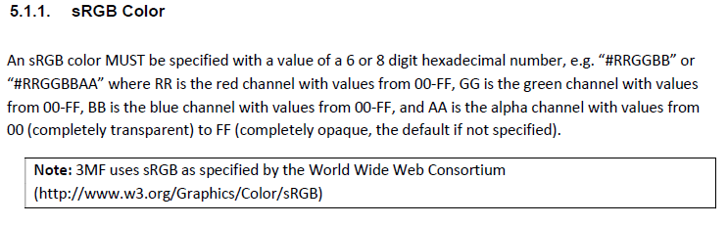
Current 3MF “A in RGBA” definition
Is defined for materials, i.e. viewing conditions, measurement conditions, transformation to a perceptually uniform color space
Is undefined for materials
In materials and properties extension: additive blending

Slide 14
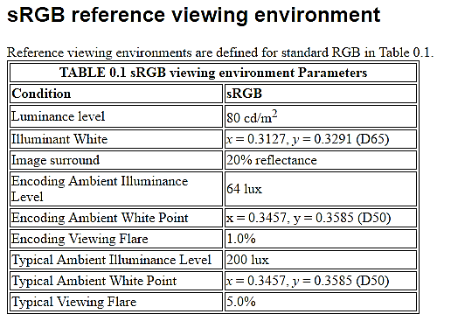
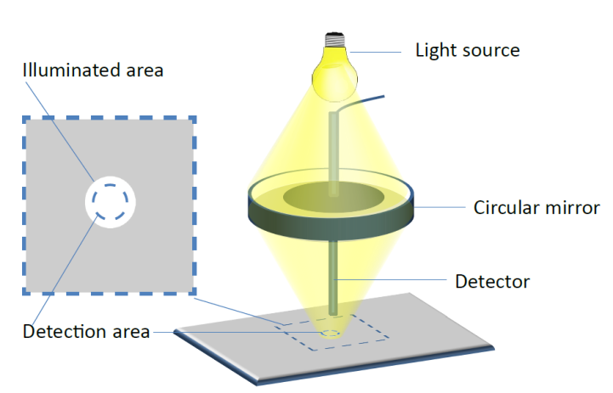
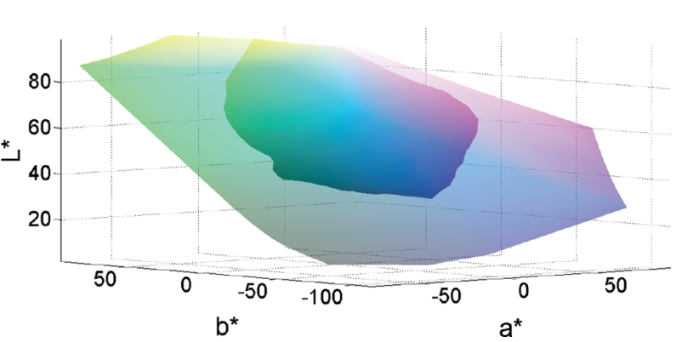
sRGB
CIE 1931 Standard Observer
Transform into the nearly perceptually-uniform CIELAB color space exist
Circular 45/0 measurement geometry for object colors defined
Measureable (ICC)
Defined Viewing Conditions
Linked to a perceptually-uniform color space

Slide 15
Light Transport and Translucency Perception

Slide 16
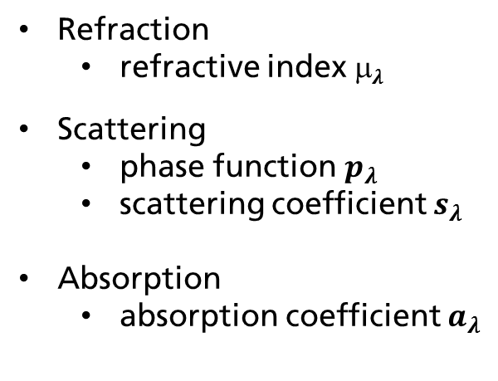

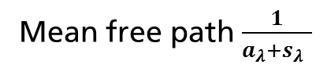
Optical Material Properties (intrinsic)
air material
Refraction
refractive index μ$λ$
Scattering
phase function $p_{λ}$
scattering coefficient $s_{λ}$
Absorption
absorption coefficient $a_{λ}$
photon
Mean free path $\frac{1}{{a_{λ}+s}_{λ} }$
Radiative Transfer Equation:
$$\frac{dI_{λ}\left(x,ω\right)}{dx}=−a_{λ}\left(x\right)I_{λ}\left(x,ω\right)−s_{λ}(x)(I_{λ}\left(x,ω\right)−\oint_{S^{2}}{I_{λ}\left(x,ω^{′}\right)p_{λ}\left(ω^{′},ω\right)dω′) }$$

Slide 17
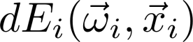
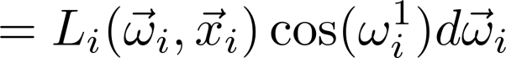
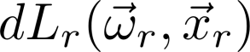
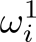
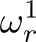
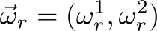
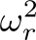
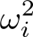
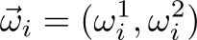
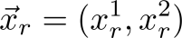
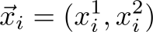
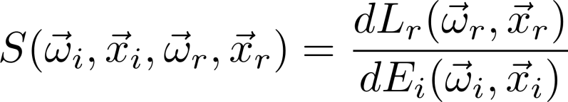
Optical Material Properties (phenomenological)
Material
Irradiance
Radiance
BSSRDF
Bidirectional Surface Scattering Reflectance Distribution Function (BSSRDF)

Slide 18

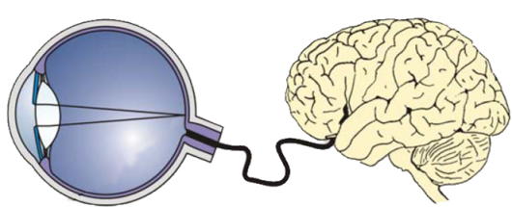
Perceptual Attributes
Color
Texture
Gloss
Translucency
Viewing Conditions
Stimulus
Human Visual System
Material

Slide 19
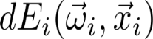
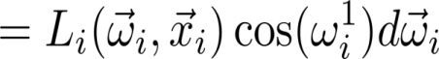
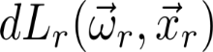
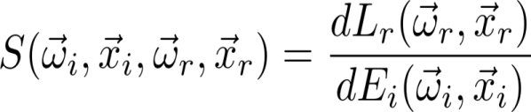
Reproducing Physical Quantities?
Why not using BSSRDFs?
High dimensionality
High memory consumption
Measurement effort
Instruments not available
Time consuming
No perceptual metric
Material
Can we reproduce given BSSRDFs?
Mostly impossible due to printing systems limits:
Absorption (coefficients)
Scattering (coefficients / function)
Refractive index
Resolution (surface roughness)

Slide 20
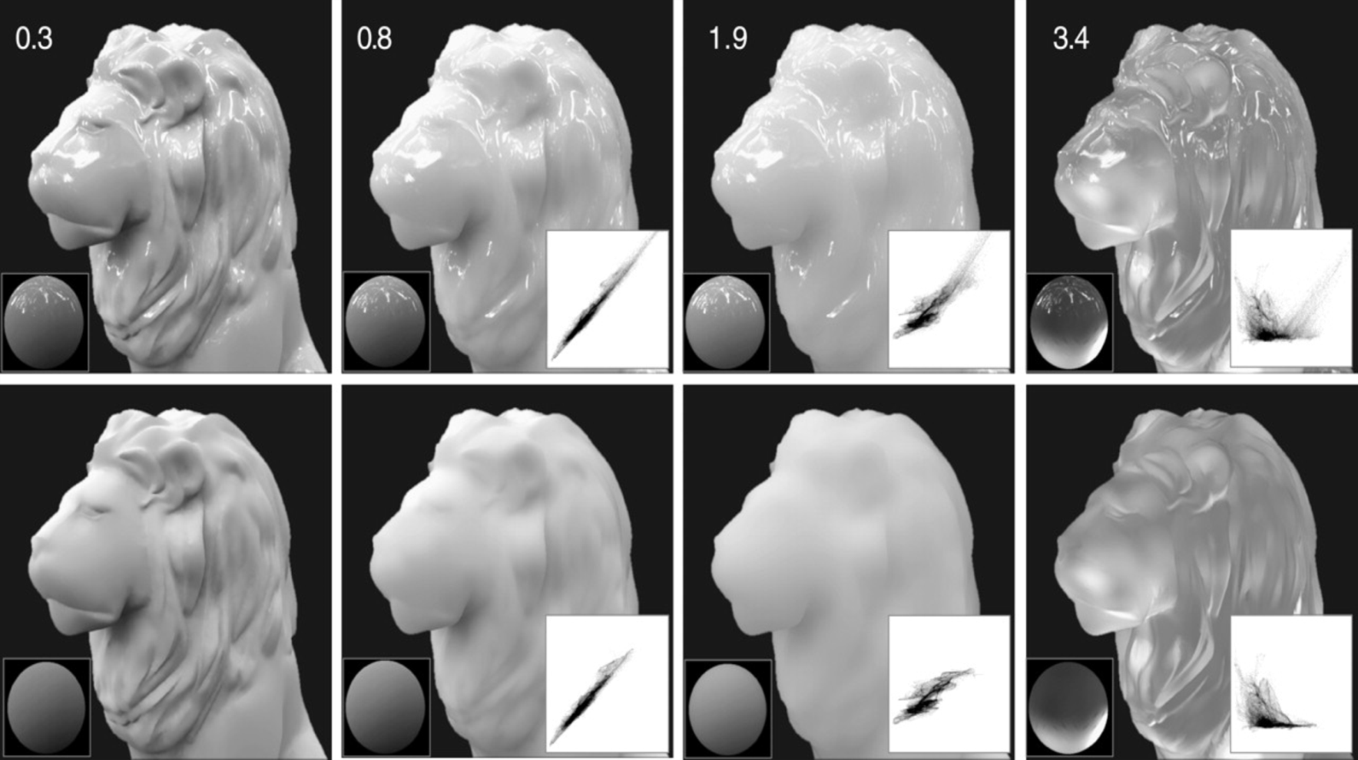
Perceptual Attributes
Perceived Translucency
“Physics of translucency is simply too complex for the [human] visual system to run the generative equations “in reverse” and estimate intrinsic physical parameters via inverse optics.
… instead the visual system relies on simple image heuristics [cues] that correlate with translucency.”
Fleming and Bülthoff, 2005
Specular
Specular removed
Decreasing Luminance Contrast
Increasing (Inverse) Lum. Contrast
Motoyoshi, 2010

Slide 21
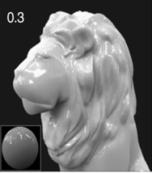
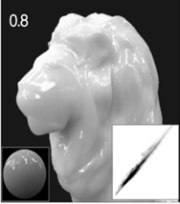
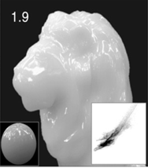
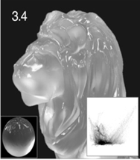
Visual cues induced by light transport
Lateral
Material
Vertical
Lateral Light Transport
Vertical Light Transport
PSF
Material
Opaque
Transparent

Slide 22
Defining A in RGBA

Slide 23
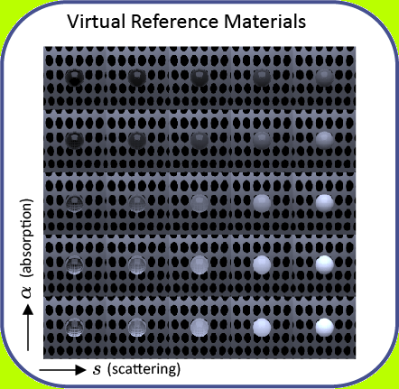

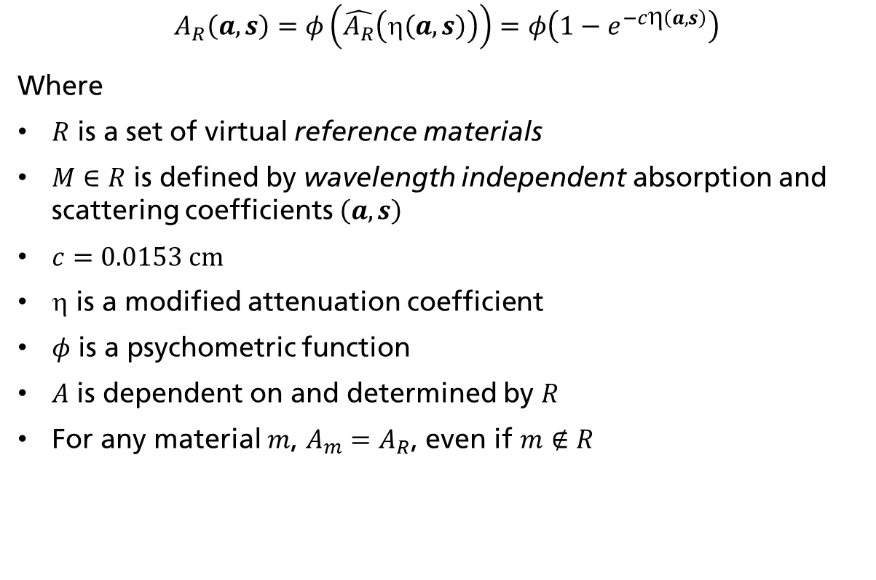
Redefining A in RGBA
Basis Radiative Transfer Equation:
$$\frac{dI_{λ}\left(x,ω\right)}{dx}=−a_{λ}\left(x\right)I_{λ}\left(x,ω\right)−s_{λ}(x)(I_{λ}\left(x,ω\right)−\oint_{S^{2}}{I_{λ}\left(x,ω^{′}\right)p_{λ}\left(ω^{′},ω\right)dω′) }$$
varying (const for λ)
varying (const for λ)
isotropic
$$A_{R}\left(a,s\right)=φ\left(\hat{A_{R}}\left(η\left(a,s\right)\right)\right)=φ\left(1−e^{−cη\left(a,s\right)}\right)$$
Where
$R$ is a set of virtual reference materials
$M∈R$ is defined by wavelength independent absorption and scattering coefficients$\left(a,s\right)$
$c=0.0153 cm$
$$ is a modified attenuation coefficient
$φ$ is a psychometric function
$A$ is dependent on and determined by $R$
For any material $m$, $A_{m}=A_{R}$, even if $m∉R$

Slide 24


Linking A, reference materials, measurements, and visual cues
To connect $A$ to the real world, we need to decide on a measurement setup.
Given the measurement setup, we first simulate measurements of the reference materials.
We obtain virtual measurements corresponding to our visual cues.

Slide 25



Linking A, reference materials, measurements, and visual cues
Now we can apply our measurement setup to real materials.
We obtain the same measurement quantities.
Look up the best-matching reference material.
Compute 𝐴.

Slide 26


Measuring Lateral and Vertical Light Transport
Lateral light transport
Vertical light transport
Barbieri Spectro LFP: Commercial reflection/transmission spectrophotometer Reflectance 45/0, Transmittance d/0

Slide 27

Measuring Lateral and Vertical Light Transport
Simulations of measurements for reference materials
CAD design of the Barbieri Spectro LFP optical path
Defined sample size (must be used also for real samples later)
Solving the spectral radiative transfer equation for the reference materials and the viewing conditions
We used the physically-based path-tracer Mitsuba
Based on these measurements the Lookup table is created
CAD Design for the measurement head
We work with Barbieri on a reflectance/transmittance spectrophotometer for automatically measuring RGBA

Slide 28

Examples
Original
Wavelength dependent absorption coefficient
Scattering coefficient 4 cm⁻¹
Phase function: Henyey-Greenstein 0.7 (forward scattering)
Reference Material
Closest reference material
Color Adjusted Ref. Mat.
Copy a*,b* pixel values from original
Copy median lightness from original

Slide 29



Examples
Original
Scat coeff. 12 cm⁻¹
Phase function: Henyey-Greenstein -0.7 (backward scattering)
Reference Material
Closest reference material
Original
Scat coeff. 12 cm⁻¹
Phase function: Henyey-Greenstein -0.7 (backward scattering)
Color Adjusted Reference Materials
Copy a*,b* pixel values from original
Copy median lightness from original

Slide 30
Perceptually-Uniform Embedding of A

Slide 31

What does Perceptual-Uniformity of A mean?
For all $x,y ∈R,x≠y:$|A$x$- A$y$| = ΔT($x,y$) where ΔT($x,y$) is the median translucency difference between $x$ and $y$ perceived by the population
We need to adjust the parameters of A to minimize the error between predicted and perceived translucency difference
Note that it is unlikely that a perfect perceptually-uniform translucency space exists (curvature, diminishing returns phenomenon)
ΔA=0.2
ΔA=0.1
ΔT=0.1
ΔA=0.2
ΔT=0.2

Slide 32


Perceptually-Uniform Embedding of A
For the reference materials:
We seek a psychometric function and a modified attenuation coefficient that embeds A into a perceptually-uniform scale, i.e. Euclidean distances agree with perceived differences
We need to know perceptual translucency differences → Psychophysical experiment
psychometric function
modified attenuation coefficient
View Point
Assumption Stevens’ power law is applicable
Assumption Scattering and absorption have different impact on perceived translucency

Slide 33
Psychophysical experiment
Use anchor pair of reference materials with a small but clearly visible translucency difference ΔT_{anchor}
Determine for well distributed reference materials and directions the same difference by conducting a psychophysical experiment:
Method of constant stimuli [Engeldrum 2000]
Color-calibrated display
Monte-carlo path tracer Mitsuba [Jakob 2010]
40 subjects (6 female, 34 male)
ΔT_{anchor}
ΔT_{anchor}

Slide 34

Psychophysical experiment
Use anchor pair of reference materials with a small but clearly visible translucency difference ΔT_{anchor}
Determine for well distributed reference materials and directions the same difference by conducting a psychophysical experiment:
Method of constant stimuli [Engeldrum 2000]
Color-calibrated display
Monte-carlo path tracer Mitsuba [Jakob 2010]
40 subjects (6 female, 34 male)
Subjects were asked: Which pair has the larger perceived translucency? (left/right)
Test pair
Anchor pair

Slide 35





Psychophysical experiment
Each experimentally determined pair t of reference materials correspond to a pair of A values with a difference of
Solve where $V$ is the set of pairs with the same perceived translucency difference as the anchor pair
Solution: $\left(p^{′},q′\right)=\left(0.4,0.6\right)$ (better uniformity than CIELAB)
$${∆A}_{\left(p,q\right)}^{}\left(t\right)$$
$${∆A}_{\left(p,q\right)}^{}\left(t\right)$$
$$\left(p^{′},q′\right)=\underset{\left(p,q\right)}{\text{arg}min}{\sum_{t∈V}{{({∆A}_{\left(p,q\right)}^{}\left(t\right)−{∆A}_{\left(p,q\right)}^{}\left(t_{a}\right))}^{2}}}$$
ΔT_{anchor}
$${∆A}_{\left(p,q\right)}^{}\left(t_{a}\right)$$
ΔT_{anchor}

Slide 36



Perceptually-Uniform Embedding of A
$\left(p,q\right)=\left(1,1\right)$
$\left(p,q\right)=\left(0.4,0.6\right)$
Absorption and scattering coefficient in
parenthesis indicating the reference material

Slide 37
Adjusting A to the print size

Slide 38

Adjusting A to the Print Size
Problem: Perceived translucency depends on the size
Size X, Material A
Size Y, Material A
Size Y, Material B

Slide 39

Adjusting A to the Print Size
Scaling an object does not change the mean scattering and absorption distances → The object appears more translucent
Scale absorption and scattering coefficients to preserve appearance
We can adjust $A$ to maintain the original translucent appearance of an object scaled by a factor $k$
$$A\left(ka,ks\right)={\left(1−{\left(1−A{\left(a,s\right)}^{\frac{1}{q}}\right)}^{k}\right)}^{q}$$
air material B
air material A

Slide 40

Adjusting A to the Print Size
(a) and (b) have same A
A is adjusted in (c) to match (b)

Slide 41
3D Printed Examples based on the A in RGBA Definition

Slide 42


3D Printed Examples
47 cm (polished)
Revealing internal structures of complex models (28 sub-part). [skin: RGBA = (1,1,1,0)]

Slide 43



Translucency transitions
Only α is altered.
10 cm

Slide 44



Translucency transitions
25 cm

Slide 45




Control over translucent appearance
10 cm
relative $α=1$
relative $α=0.54$

Slide 46


Reproducing translucent appearance
3D Copy
Real wax

Slide 47



Increasing design space
Real wax
Appearance copy
Translucency copy
Same RGBA
Same shape + α

Slide 48




Reproducing translucent appearance
violet stone
interpolate
green stone
interpolate
green soap

Slide 49

Reproducing translucent appearance

Slide 50
Summary
Proposed definition of A in RGBA for a joint color and translucency space is suitable for digital fabrication
Low dimensional
Encoding is supported by 3MF
Encoding is supported by various design tools
Device independent, which is necessary for an open system architecture
Measurable with commercial reflectance/transmittance spectrophotometer
Nearly perceptually uniform (better than CIELAB for color)
Adjustable to print size for preserving translucency appearance at different scale

Slide 51
Acknowledgements
Grants:
AIF IGF-Vorhaben Nr. 18478 (Prozessstandardisierung im grafischen 3D-Druck für 3DP- und FDM-Verfahren)
Scan4Reco project funded by EU Horizon 2020 Framework Programme under grant agreement no 665091
Fraunhofer Attract 008-600075
Markus Barbieri (Spectro LFP CAD Design)

Slide 52
Philipp Urban
Head of Competence Center 3D Printing Technology
Fraunhofer Institute for Computer Graphics Research IGD
Fraunhoferstraße 5
64283 Darmstadt
Tel +49 6151 155 –250 | Fax –480
Philipp.urban@igd.fraunhofer.de
www.igd.fraunhofer.de

Slide 53
Backup Slides

Slide 54
Meaningful Edge-Loss Measurements

Slide 55



Meaningful Edge-Loss Measurements? (Detectability)
Each red dot indicates the edges-loss measurement for a PSF with
a decay of 50% at the corresponding cpd
All edge-loss difference measurements are larger than ΔL* =1 and detectable by spectrophotometers used in graphic arts

Slide 56

Meaningful Edge-Loss Measurements? (Discrimination)
Spectrohotometric distrimination threshold: 0.5 Based on medium term repeatability of 0.24 [Wyble and Rich 2007]
Human discrimination
Viewing distance 80cm
Convolute with CSF [iCAM framework, Fairchild and Johnson 2004]
Pixel-wise difference
Average over non-zero differences
Threshold ΔL* =1
Neither
Human nor
Spectro
Human and
Spectro
only
Spectro

Slide 57
Perceptually-Uniform Embedding of A

Slide 58

Perceptually-Uniform Embedding of A
We conducted visual experiments using the method of constant stimuli on samples presented on a color calibrated display.
A virtual viewing booth was designed with defined viewing conditions
Rendering was performed by solving the spectral radiative transfer equation using the physically-based path-tracer Mitsuba

Slide 59

Perceptually-Uniform Embedding of A
Method of Constant Stimuli
Binary results were evaluated using probit analysis
T50 distances in scattering coefficient were determined T50 = Distance from a center sample at which 50% of the subjects perceived the anchor to be larger and 50% to be smaller

Slide 60


Perceptually-Uniform Embedding of A
The parameters were optimized for the visual translucency differences by minimizing the perceptual disagreement resulting in:
We computed the Standardized REsidual Sum of Squares (STRESS) index to quantify the difference between measured and predicted perceived difference)
STRESS index dropped from 49.7 (no optimization) to 32.7 (approx. similar to CIE94 color difference formula in CIELAB)

